Slide 1
Topic of discussion
Boot loader
Kernel
Root
(On the basis of Android ROM)

Slide 2
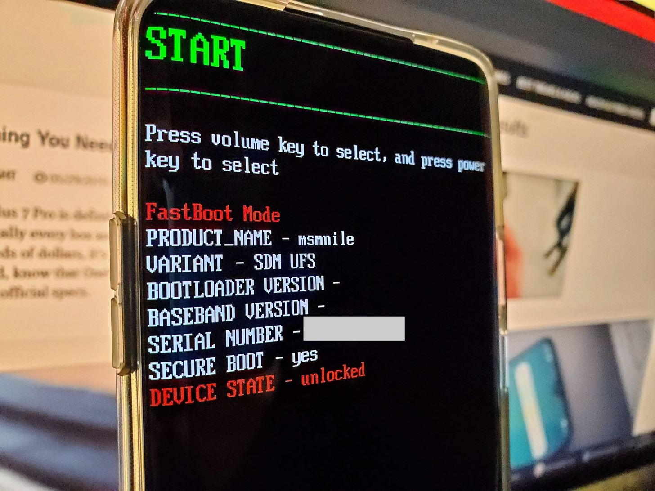
Bootloader
A bootloader is a vendor-proprietary image responsible for bringing up the kernel on a device.
TEE?

Slide 3

Kernel
LTS Linux kernel
Version 4.X

Slide 4

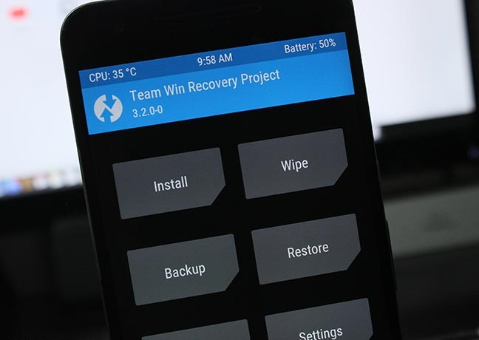
Root
Opensource tools
TWRP Recovery
Magisk (Systemlessly)

Slide 5

Modules
Custom ROM
Custom kernel
Customize everything

Slide 6

Brick (Soft & hard)
Boot loop
System app uninstall
Netflix, Games, Banking apps might not alloweed.

Slide 7

Tools websites:
twrp.me
Github.com/topjohnwu/Magisk

Slide 8

xda-developers.com
android.stackexchange.com
Reddit, Slack & Discord communities

Slide 9
Hack-tools
Net-Hunter (Used to WiFi hacking)
Lucky patcher (Used to bypass PlayStore purchase)
Termux (terminal emulator)

